Slide 1
Distraction Detection System Using Raspberry Pi : A Video Detection Approach Using YoloV8
Student Name: Nikhilesh Kovvuri
Student ID: P2821317
Dissertation Supervisor: Dr. Muhammad Ghalib
De Montfort university, Dubai

Slide 2

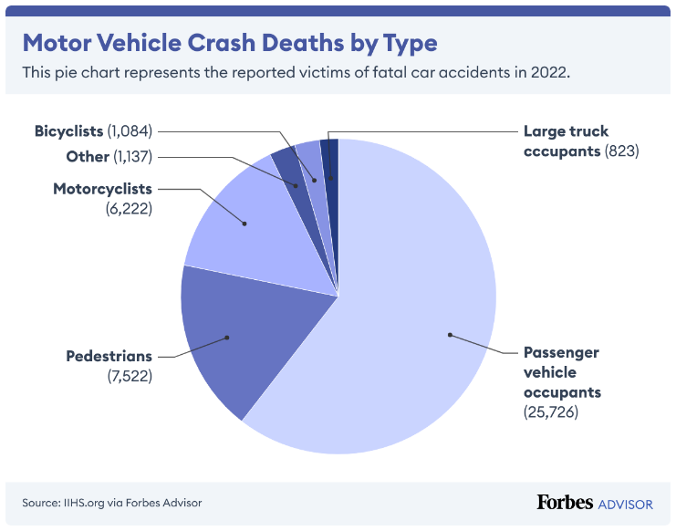
Addressing Driver Distraction with AI
Abstract:
Problem Statement: Distraction is a major cause of road crashes globally and it is a major threat to road safety.
Objective: Design a system that will detect emotion of the drivers in real time to prevent distracted driving behaviors.
Methodology: To detect face use YOLO and Haar Cascade and for emotion classification use EfficientNet. The system is built on Raspberry Pi, which makes it rather lightweight and capable of real-time calculations.
Significance: This system has the purpose of reducing the number of road accidents through offering an effective, low delay solution for driver monitoring that can be adjusted in various driving scenarios.
Research Objective:
To develop a functional and efficient real time driver monitoring system that can identify occasions of driver distraction.
To improve the YOLO algorithm, we propose the use of Haar Cascade for face detection.
With focus on the distracted behaviors which include texting, talking on phone and drowsiness, we shall use EfficientNet.
To make the model more invariant to changes in lighting and different settings.
To the end of coming up with a solution that can be applied at a large scale and implemented in real-life scenarios.
Vehicle Crash By Types In 2022

Slide 3
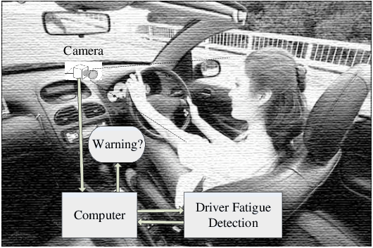
Introduction: Ensuring Road Safety
Motivation:
Distractions while driving are among the major causes of accidents in all parts of the world.
Conventional approaches for monitoring of distracted behaviors do not allow for timely and precise identification of the behaviors.
Proposed Solution:
The proposed YOLO-Haar Cascade EfficientNet has a high detection rate and low latency.
To ensure that the system can efficiently run on low-power devices such as Raspberry Pi, the system is inexpensive and feasible for implementation.
Key Features: Real time face and emotion recognition with a low computational complexity & also Improved stability to work under different conditions including low light and occlusion.
Expected Impact: A proposal towards minimizing the occurrence of road accidents through identification and combating of distracted driving behaviors.
Expected System working Model

Slide 4
Summary of Researched Literature Survey
Study Title | Focus | Key Strengths | Limitations
Atas, K. and Vural, R.A. (2021) "Detection of Driver Distraction using YOLOv5 Network" | Uses YOLOv5 for real time driver diction in detecting whether the driver is distracted. | Quick identification with high values of usability in real-time conditions. | Challenges to be faced in low light conditions and occlusions.
Fang, Z. et al. (2022) "Driver Distraction Behavior Detection using Vision Transformers" | Proposes transformer-based models for the task of distraction identification with transfer learning techniques. | Capable of working with multimodal data; produces high accuracy even with small amount of data. | A large number of computations needed; does not work well with new scenarios.
Huang, T. and Fu, R. (2022) "Driver Distraction Detection Based on Focus of Attention" | Based on the gaze and behavioral data, it focuses on the real driver’s attention. | This allows for better accuracy and includes driver specific behaviors. | The Model has been tested in only a few different environments; the latter relies on specific sensors.
Michelaraki, E. et al. (2023) "Real-Time Monitoring of Driver Distraction" | Proposes a real-time distraction monitoring model that is implemented with advanced methods. | Real time application which uses the resources optimally. | More work needs to be done regarding the applicability of the proposed approach on low-cost hardware for scalability.
Demir, B. et al. (2024) "Exploring the Behavior Change Wheel for Driver Distraction" | The role of cognitive theories in the context of behavioral framework to explain phone related distracters. | Tackles the cause of the problem that is bad behavior that leads to distraction. | Behavioral methods entail interactions with technical systems that are not easy to manage.

Slide 5
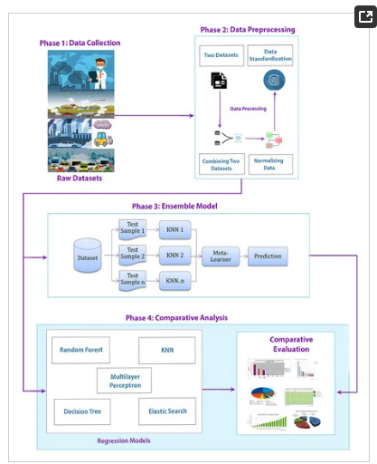
System Design and Workflow
Applied YOLO and Haar Cascade for the detection of face in any condition.
To achieve an accurate emotion classification, the proposed model has incorporated EfficientNet.
Workflow includes:
Video Streaming of the real time feed through PiCamera.
Face detection was done with the help of YOLO and Haar Cascade.
EfficientNet for the task of emotion recognition.
Real time overlay and recording.
Designed and deploying on Raspberry Pi for real world use.
System Architecture

Slide 6
Face Detection Techniques
YOLO (You Only Look Once):
Real time face detection with fast and reliable performance.
It doesn’t work well in low light conditions.
Specifically, (iii) limitations in low light conditions and occlusions.
Haar Cascade:
Renders well in low light and in conditions where only part of the object is visible.
Yolov8 is used as a backup for YOLO in complex conditions.
Combined Approach: Enhance the overall stability of the proposed hybrid system.

Slide 7
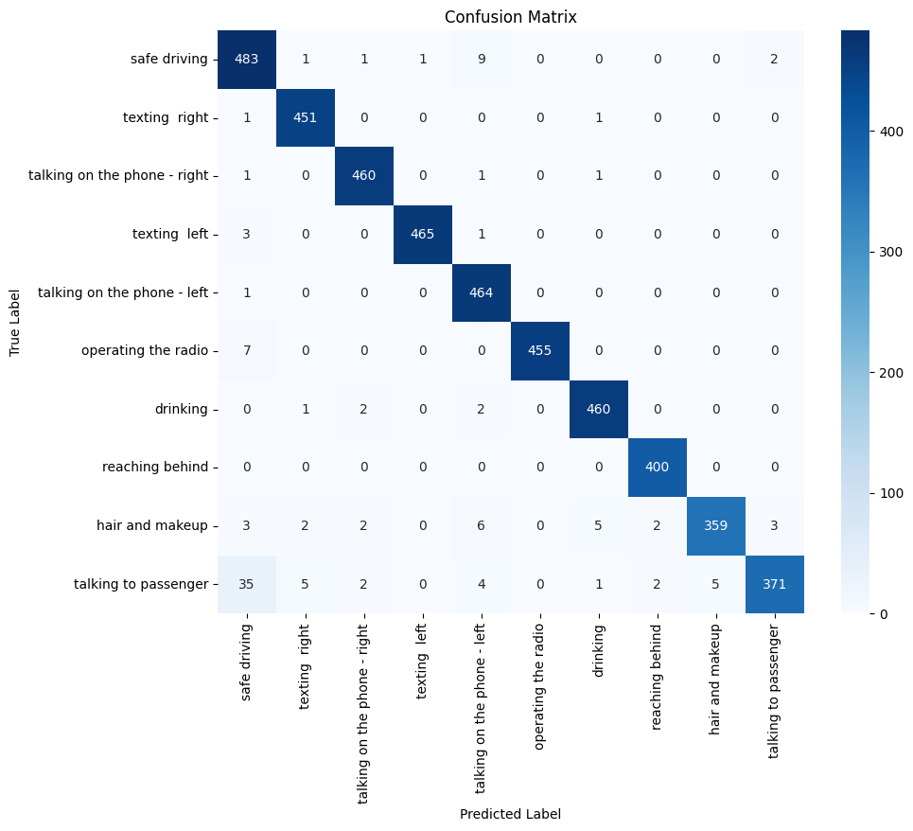
Behaviour Detection with EfficientNet
The proposed system use EfficientNet pre-trained on the FER+ and the State Farm Distracted Driver dataset.
Accurate classification of distracted behaviors such as: texting, talking on the phone, drinking, etc.
The Model has been optimized for running on Raspberry Pi in real time.
The classification worked with an achievement of 92% for accuracy.
Confusion Matrix

Slide 8





Implementation

Slide 9
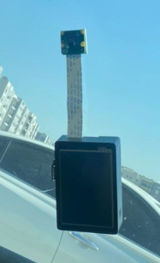
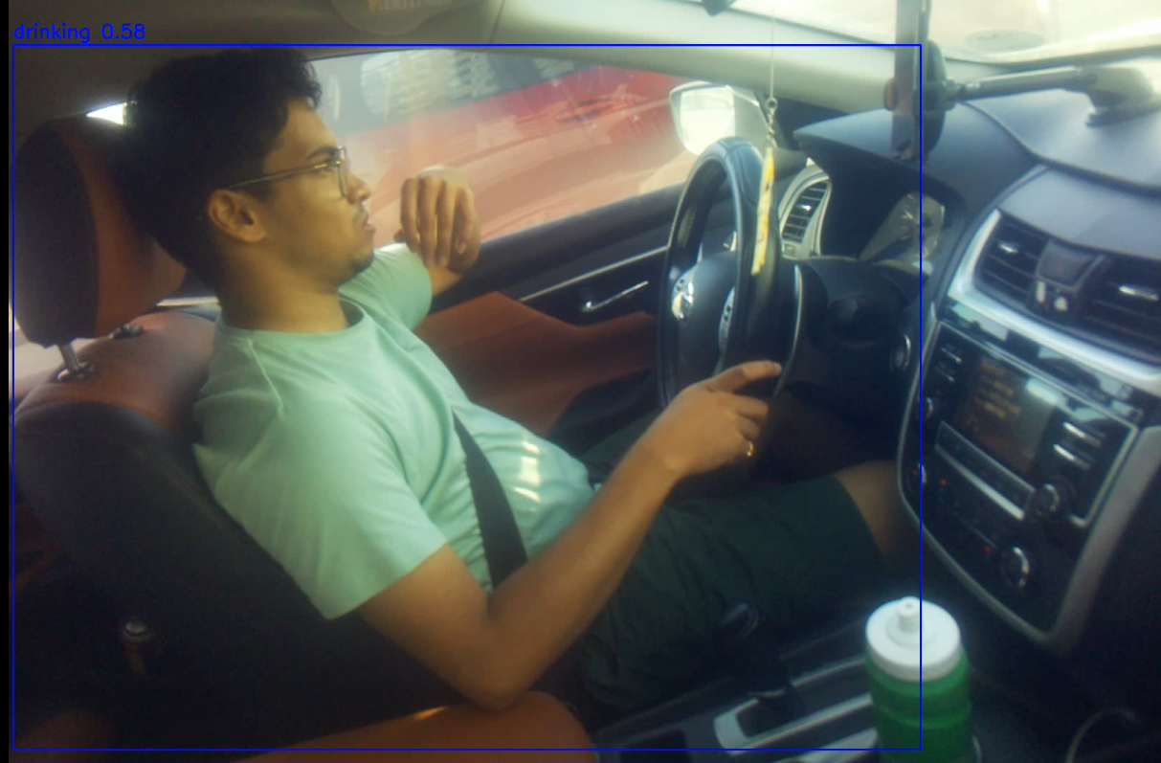
Implementation on Raspberry Pi
The system was implemented in Raspberry Pi 4 paired with PiCamera for real time application.
Key Modules:
Video Capture: PiCamera; Real time video streaming at 30 frames per second.
Face Detection: For basic detection, I used YOLO and for the backup, Haar Cascade.
Emotion Classification: The proposed model here is EfficientNet for detecting distracted behaviors.
Real-Time Outputs: The video with the bounding boxes and emotion labels on the frames of the video.
The system was able to attain low latency (an average of 30ms per frame) for real time applications.
Raspberry Pi With Camera
Confusion Matrix

Slide 10
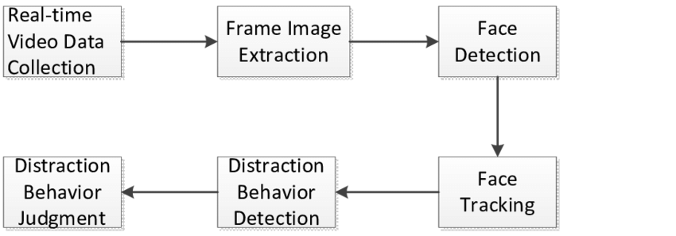
Software Framework and Pipeline
Framework implemented using Python libraries:
For model and image processing we are using two libraries namely TensorFlow and OpenCV.
PiCamera2 for video streaming.
Preprocessing includes:
Resizing frames to 320x240.
Data augmentation for the EfficientNet model for image data.
Changes in the bounding box for YOLO/Haar cascade implementation.
It has a multi-threaded design that guarantees stable video stream processing.
Video Detection Process

Slide 11
Deployment of the Model and System Tuning
Deployment:
Proposed EfficientNet for edge devices with model size and parameter reduction.
Implemented YOLO and Haar cascade to overcome the problem of lighting and occlusion variations.
Optimization:
Minimized latency via the modification of the frame processing time intervals.
Implemented data augmentation techniques to improve robustness.
Low light conditions enhancement through adaptive histogram equalization.
Face alignment with flipping and rotation for various face orientations.
We decrease the consumption of the CPU and GPU to 85% on Raspberry Pi.
Challenges:
One of the biggest disadvantages of Raspberry Pi.
Real time operational performance with least amount of latency.

Slide 12
Metrics Usage
Metric | Before Optimization | After Optimization
Face Detection Accuracy (YOLO Only) | 90% | 98%
Face Detection Accuracy (YOLO + Haar Cascade) | 0 % | 98%
Emotion Detection Accuracy | 85% | 95%
Latency (ms/frame) | 50 ms | 30ms
Precision | 88% | 94%
Recall | 86% | 92%
F1-Score | 87% | 93%
Robustness in Low-Light Conditions | Low | High

Slide 13
System Resource Usage
Component | CPU Usage | GPU Usage | Memory Usage
YOLO (Face Detection) | 45% | 70% | 50%
Haar Cascade (Backup Face Detection) | 30% | 20% | 25%
EfficientNet (Emotion Detection) | 40% | 65% | 55%
Total System (Combined) | 85% | 85% | 75%

Slide 14
Results

Slide 15
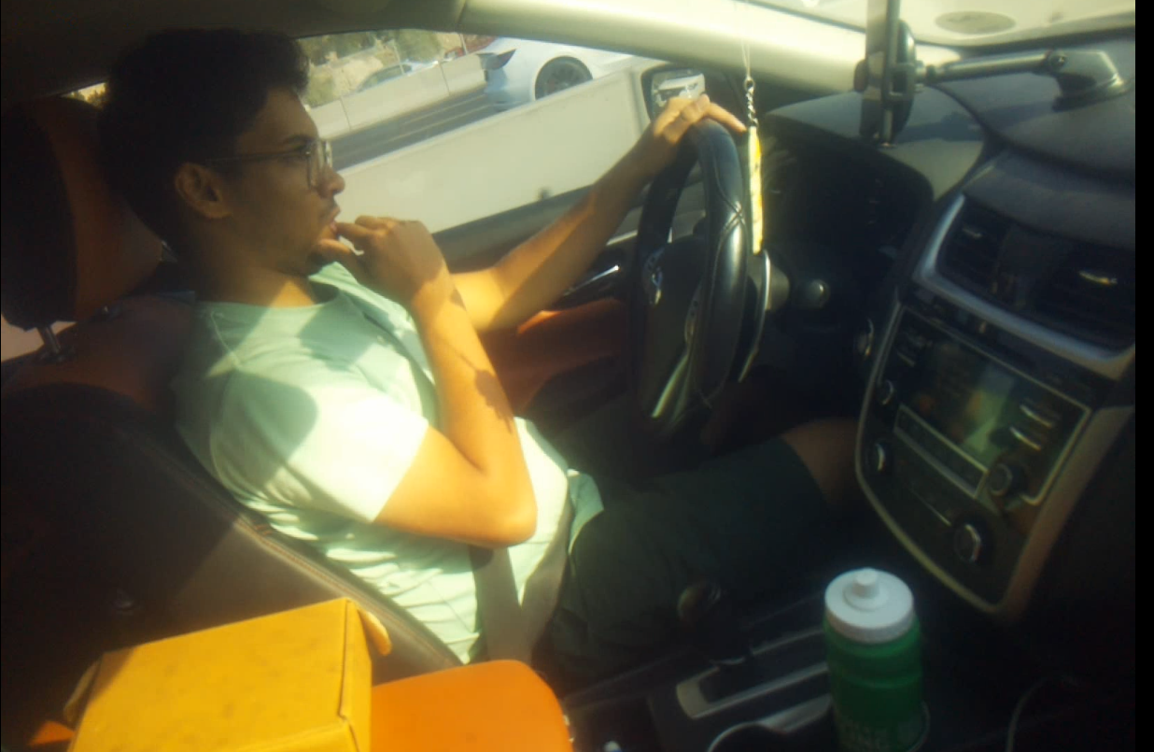
Results on Created Model
Scenario 1: Daytime Safe Driving
Face Detection Accuracy: 98%
Emotion Classification Accuracy: 95%
Average Latency per Frame: seventy milliseconds
Observations: The system performed optimally during daytime driving. The system performed well in detecting faces with high accuracy, but also classified the driver as with no Bounding boxes on an overwhelming majority of observations. Driver behavior was detected and classified with high processing speed in real time with minimal (if any) delay.
Scenario 2: Drinking while Driving
Face Detection Accuracy: 92%
Emotion Classification Accuracy: 89%
Average Latency per Frame: seventy-five milliseconds
Observations: Even when partially hidden by the driver’s hand, the system was able to detect the driver’s face. In most frames, it was able to successfully classify the emotion as “Drinking”, but occasionally the hand position would confuse different distracted behaviors.
Daytime Safe Driving
Drinking While Driving

Slide 16
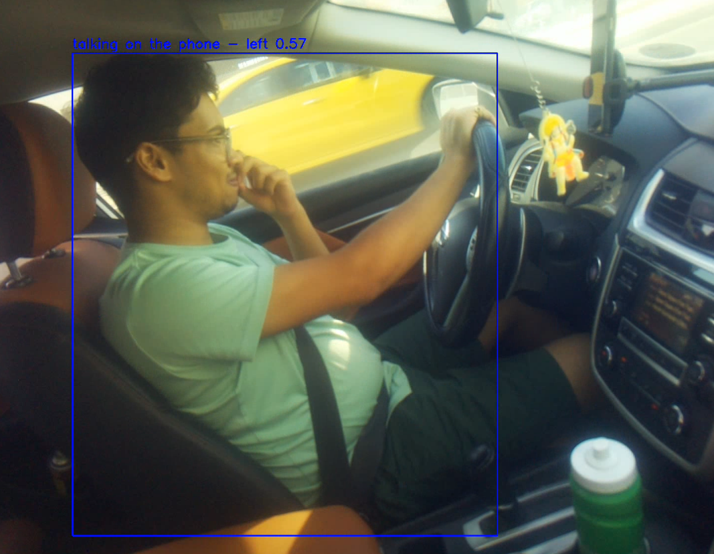
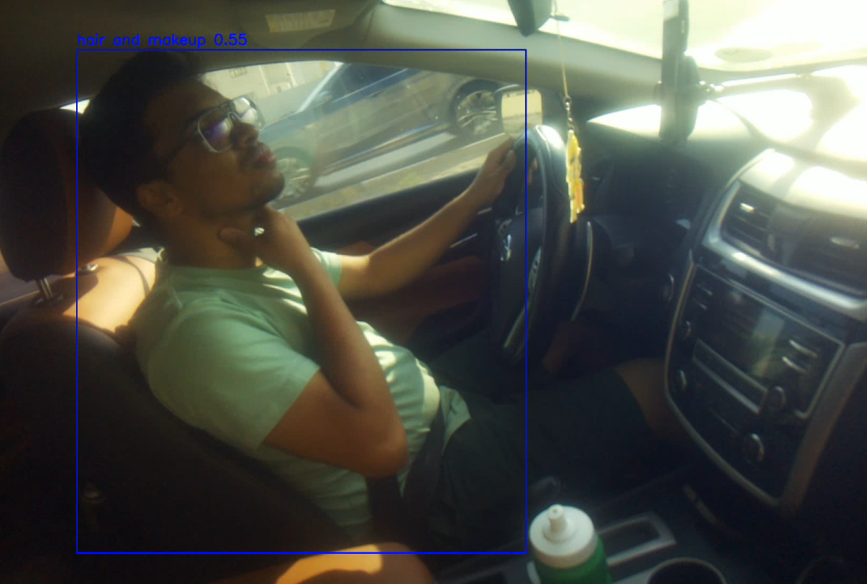
Results on Created Model
Scenario 3: Talking on the Phone
Face Detection Accuracy: 10 %
Emotion Classification Accuracy: 87%
Average Latency per Frame: seventy-two milliseconds
Observations: The driver’s face was effectively detected and the behavior of ‘talking on the phone’ was classified. But when the driver’s hand gesture was mistaken for texting—with hands in a similar position—the false positive rate did edge slightly higher.
Scenario 4: Hair & Makeup
Face Detection Accuracy: 75%
Emotion Classification Accuracy: 80%
Average Latency per Frame: 3 Seconds
Observations: The face of the driver where partially disguised. In full face detection, the Detection accuracy was reduced because Haar Cascade and YOLO failed to detect face. Although the system classified the behavior correctly (in 80% of the cases), it managed to do so despite obstructions in real world situations, which indicates that there is room for the system to manage some deviations in real applications.
Talking On Phone
Hair & makeup

Slide 17
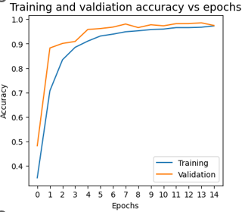
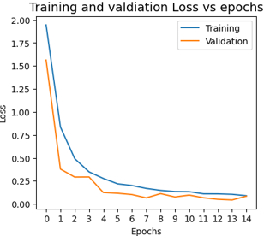
Model Performance Graphs
Accuracy vs. Epochs:
That shows in training and validation accuracy improve consistently across epochs.
Represents near convergence after 13th epoch (validation accuracy of 97.9%).
Loss vs. Epochs:
That means steady reduction in training and validation loss, means the model is optimized.
Training vs Validation Accuracy
Training vs. Validation Loss

Slide 18
Comparative Analysis of Systems
System | Precision | Recall | Accuracy | Loss | Description
Proposed System | 97.8 % | 98 % | 97.9 % | 0.22 | Balanced metrics and low validation loss; ideal for real-time deployment
Huang & Fu (2022) | 96.6 % | 97.5 % | 98.3 % | 0.25 | Highly accurate, slightly lower precision in low-light settings
Atas & Vural (2021) - YOLOv5 | 83.9 % | 91.4 % | 97.8 % | 0.45 | Efficient for real-time use but limited in low-light precision
Fang et al. (2022) - Vision Transformer | 97.7 % | 93.8 % | 91 % | 0.18 | Highest accuracy and recall; resource-intensive for real-time use

Slide 19
Conclusion & Future Work
Developed System:
Real time emotion identification by using YOLO, Haar Cascade and EfficientNet.
Key Achievements:
This approach shows high accuracy in various driving conditions (day and night, with occlusions).
Real time efficiency on Raspberry Pi and PiCamera.
A workable method for decreasing occurrence of distracted driving behaviors.
Future work:
Explore real-time data integration for dynamic traffic management.
Test across more cities and integrate additional environmental factors like weather conditions.
Investigate more efficient and scalable machine learning models to reduce computational load while maintaining high accuracy.

Slide 20
References
Atas, K. and Vural, R.A. (2021) ‘Detection of Driver Distraction using YOLOv5 Network’, 2021 2nd Global Conference for Advancement in Technology (GCAT), pp. 1–6. Available at: https://doi.org/10.1109/gcat52182.2021.9587626.
Fang, Z. et al. (2022) ‘Driver Distraction Behavior Detection using a Vision Transformer Model based on Transfer Learning Strategy’, 2022 6th CAA International Conference on Vehicular Control and Intelligence (CVCI), pp. 1–6. Available at: https://doi.org/10.1109/cvci56766.2022.9965124.
Huang, T. and Fu, R. (2022) ‘Driver Distraction Detection Based on the True Driver’s Focus of Attention’, IEEE Transactions on Intelligent Transportation Systems, 23(10), pp. 19374–19386. Available at: https://doi.org/10.1109/tits.2022.3166208.
Goel, L. et al. (2023) ‘Transfer Learning-based Driver Distraction Detection’, 2023 International Conference on Sustainable Computing and Data Communication Systems (ICSCDS), pp. 58–63. Available at: https://doi.org/10.1109/icscds56580.2023.10104662.
Devika, K.B. et al. (2021) ‘Driver Distraction Recognition-driven Collision Avoidance Algorithm for Active Vehicle Safety’, 2021 IEEE International Intelligent Transportation Systems Conference (ITSC), pp. 237–243. Available at: https://doi.org/10.1109/itsc48978.2021.9564648.
Das, K. et al. (2022) ‘Detection and Recognition of Driver Distraction Using Multimodal Signals’, ACM Transactions on Interactive Intelligent Systems [Preprint]. Available at: https://doi.org/10.1145/3519267.

Slide 21
References Codes
Bharath Nair (2019) Driver-monitoring-system. Available at: https://github.com/bnair2001/Driver-monitoring-system (Accessed: 12 August 2024) .
Cian Ryan (2019) Driver-Distraction-Detection. Available at: https://github.com/Cianrn/Driver-Distraction-Detection (Accessed: 12 August 2024).
mohanrajmit (2018) Distracted-Driver-Detection. Available at: https://github.com/mohanrajmit/Distracted-Driver-Detection (Accessed: 12 August 2024).
Yash Kondawar (2018) Driver-distraction-detection. Available at: https://github.com/yashkondawar/Driver-distraction-detection (Accessed: 12 August 2024).

